Slide 1

“E – Health Care Website”
Institute of Engineering & Technology
SESSION : 2021 – 22
Submitted By :
Name: Ayush Sharma
Id : 191500201
Name : Shivendra Singh Chauhan
Id : 191500776
Name : Yashraj Singh
Id : 191500940
Supervised By : Mr. Akash kumar Choudhary
Technical Trainer - Institute of Engineering & Technology

Slide 2
INDEX
INTRODUCTION
OBJECTIVES
FUTURE SCOPE OF PROJECT
MODULE DESCRIPTION
USER INTERFACE
CONCLUSION
REFERENCES & BIBLIOGRAPHY

Slide 3
INTRODUCTION
E Health Care Online Appointment System is a Web Development Project. It is smart appointment booking system that provides patients or any user an easy way of booking a doctor’s appointment online. This is a website that overcomes the issue of managing and booking appointments according to user’s choice or demands. The task sometimes becomes very tedious for the compounder or doctor himself in manually allotting appointments for the users as per their availability. Hence this project offers an effective solution where users can view various booking slots available and select the preferred date and time. The already booked space will be view in “My Appointment” Button. The application uses HTML , CSS & JavaScript as a front-end and SQL database and PHP as the back-end.

Slide 4
Objectives
24*7 booking: Anytime Anywhere :
A doctor appointment booking system, available on the internet, allows patients to book an appointment from the comfort of their homes, using their computer, laptop or mobile, and at any time. No matter where they are, they can contact doctors of their choice in any location. Even when they are traveling they can consult with their doctor.
Organise your schedule better :
Imagine a situation where multiple appointments are queued up because of manual error. As a doctor, you control the number of people who would be at your clinic at any point of time. This is particularly important given that social distancing is becoming the new normal. With an online appointment booking system, the doctor is in full control and can plan his/her day without any sense of trepidation.

Slide 5
Making employees and staff more productive :
A doctor appointment booking system is a self-service tool for patients to book appointments. Your staff have their time released from handling phone calls from patients desiring appointments. Instead they can focus on other tasks and improve their productivity.
Access appointments on your computer, laptop and mobile phone :
As a doctor, you can access the patient appointment information on any device. You should have the ability cancel appointments in the event of any emergency. The online appointment system give you all the appointment details at any day time.

Slide 6
Improves patient satisfaction :
Patient experience is of paramount importance. No patient would like an experience that is not smooth. An online doctor appointment system enhances patient satisfaction. Patients no longer have to be worried about the wait times in your clinic. They can plan their daily schedule better. They spend less time waiting to meet the doctor. All this goes a long way to enhance patient satisfaction.
Time-Saving :
The staff spends less time on managing appointments, and phone booking, and can, therefore, use their free time for more urgent and vital tasks. The patients can also save time as there is no need for calling the hospital and booking an appointment in the middle of their busy schedule.

Slide 7
Multiple locations and multiple doctors :
A good online doctor appointment booking system can manage multiple locations and multiple doctors. Your clinic may be operational in multiple places and each clinic may have multiple doctors each of who is available in a particular time slot. Does your system have the capability of managing these complexities? There should also be no requirement to have multiple staff to manage all this. Instead the system should manage multiple locations and doctors.

Slide 8
Future Scope of the Project
E Health Care Online Appointment System provides patients or any customer an easy way of booking a doctor’s appointment online. This is an internet based system that overcomes the issue of managing and booking appointments according to customer’s choice or requirements. The task sometimes becomes very tedious for the compounder or doctor himself in manually allotting appointments for the customer as per their availability. Hence this project offers an effective solution where customers can view many booking slots available and select the preferred date and time. The system uses HTML , CSS & JavaScript as a front-end and MySQL database and PHP as the back-end. The Doctor Appointment System. It can also maintain list of users & doctors , available appointment time, book appointment, cancel appointment, view his appointment history.

Slide 9
In a nutshell, it can be summarized that the future scope of the project circles
around maintaining information regarding:
We can give more advance Web Application or software for Doctor Appointment System including more facilities
We will host the platform on online servers to make it accessible worldwide
Integrate multiple load balancers to distribute the loads of the system
Create the master and slave database structure to reduce the overload of the database queries
Implement the backup mechanism for taking backup of codebase and database
on regular basis on different servers

Slide 10
Module Description
A module description provides detailed information about the module and its supported components, which is accessible in different manners.
User (patient) Module : The Users have to first register themselves to login into the system and main objective of this module is provide all the functionality realted to patient.
User Registration Page
This module will help the user to register by providing the details.
User Login Page
This module will help the user to Login by providing the Email & Password
Edit Profile For User
Forgot password for User
Change Password for User
Book appointment page
This module will help for the user by booking the appointment of the doctor.
Consulting (to doctor)
In this module patient can consult to the doctor by droping the message.

Slide 11
Doctor Module : The main objective for developing this module is provide all the functionality related to doctor. This is a role based module where admin can perform each and every operations on data. The access level restrictions has also been implemented on the project.
• Doctor Registration Page
• Doctor Login Page
- Edit Profile For Doctor
- Forgot password for Doctor
- Change Password for Doctor
• Appointment Request Page (Approve and reject the appointments)
• Update Schedule page
• Message page
• Doctor : With Limited Access

Slide 12
Admin Module : The system is under supervision of admin who manages the bookings made and main objective of this module is provide all the functionality realted to admin.
• Admin can Add New Doctors
• Manage Doctors Registration Request page
• Admin will be able to delete the records of the patient
• Admin : With Full Access
• Admin Can View :
- Registered users
- Registered Doctors
- List of all Appointments

Slide 13
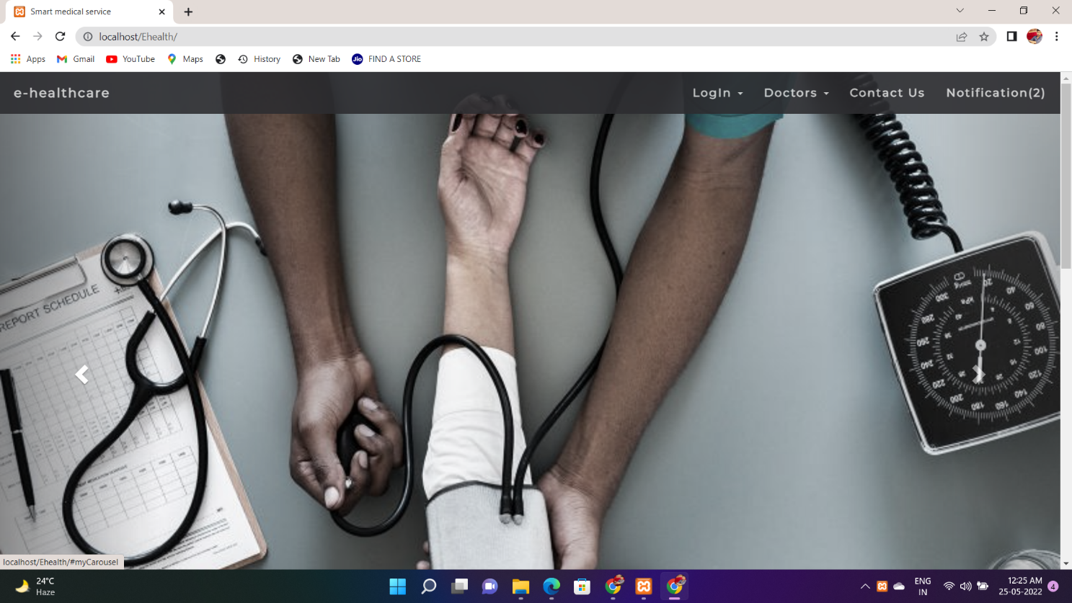
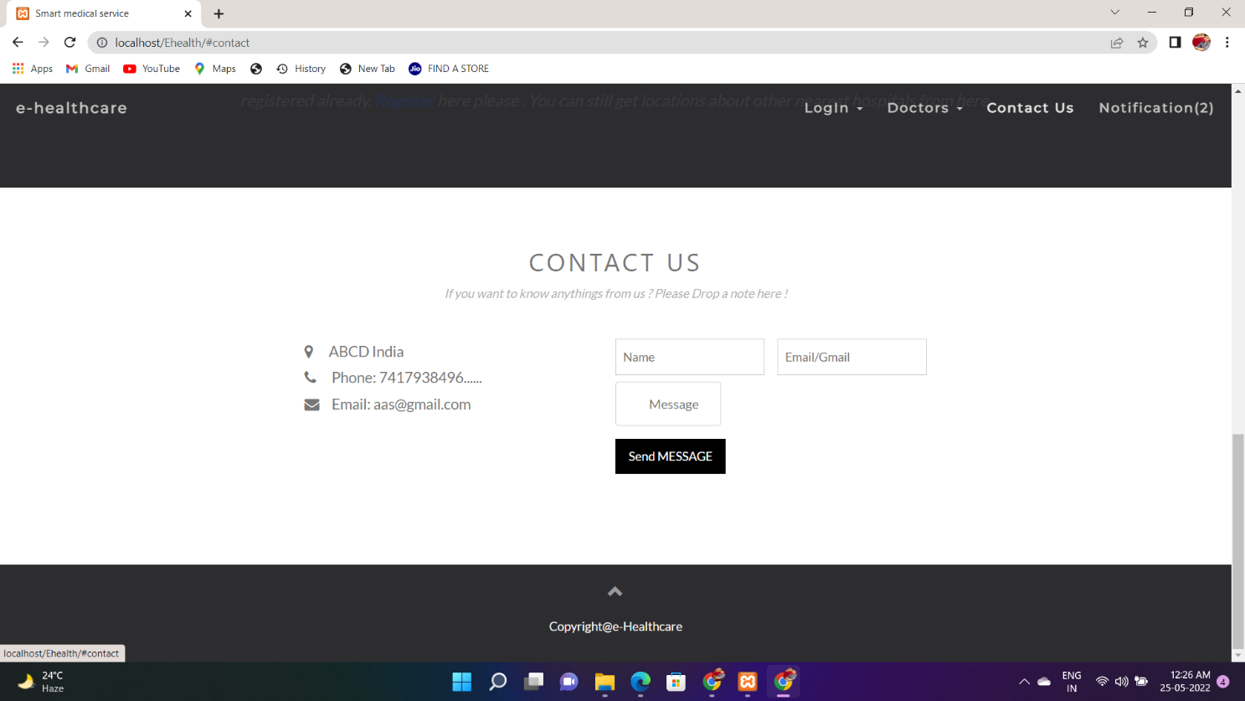
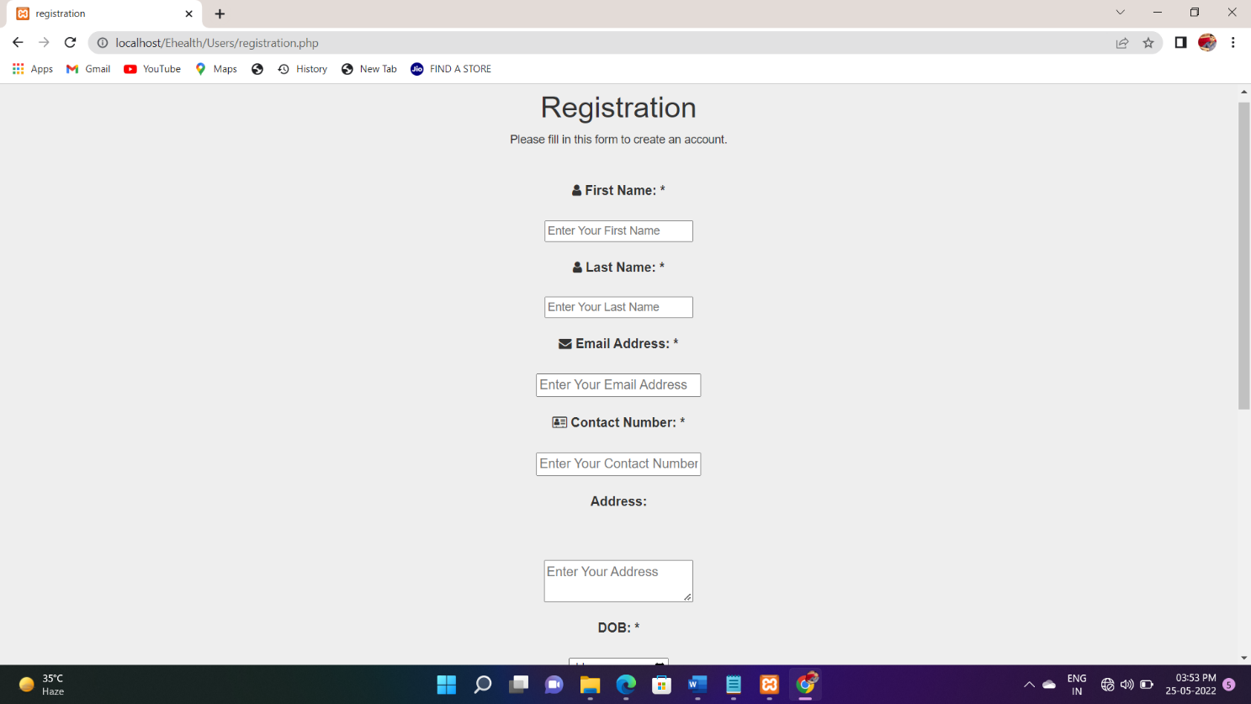
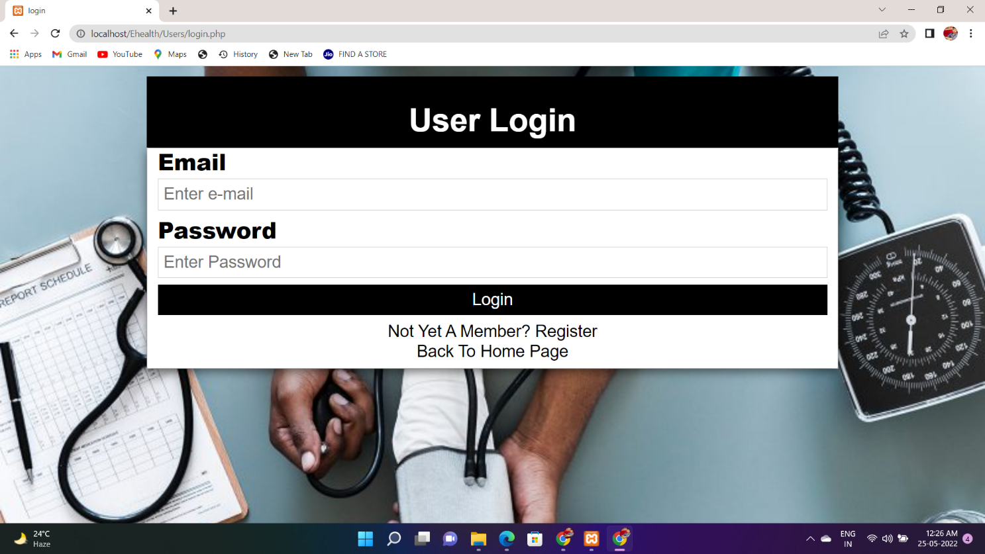
User Interface
Figure 1 : Website Home Page
Figure 2 : Contact Us
Figure 3 : User Registration page
Figure 4 : User Login Page

Slide 14
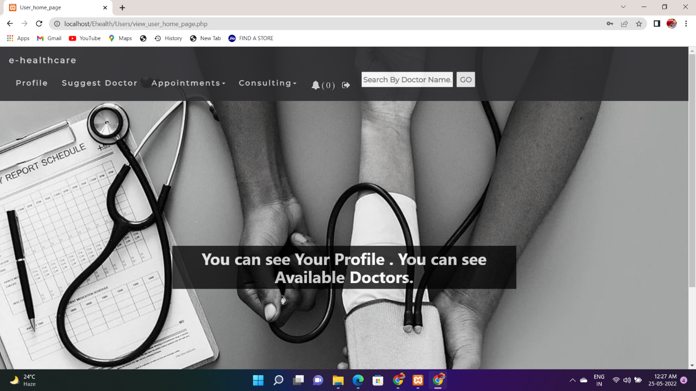
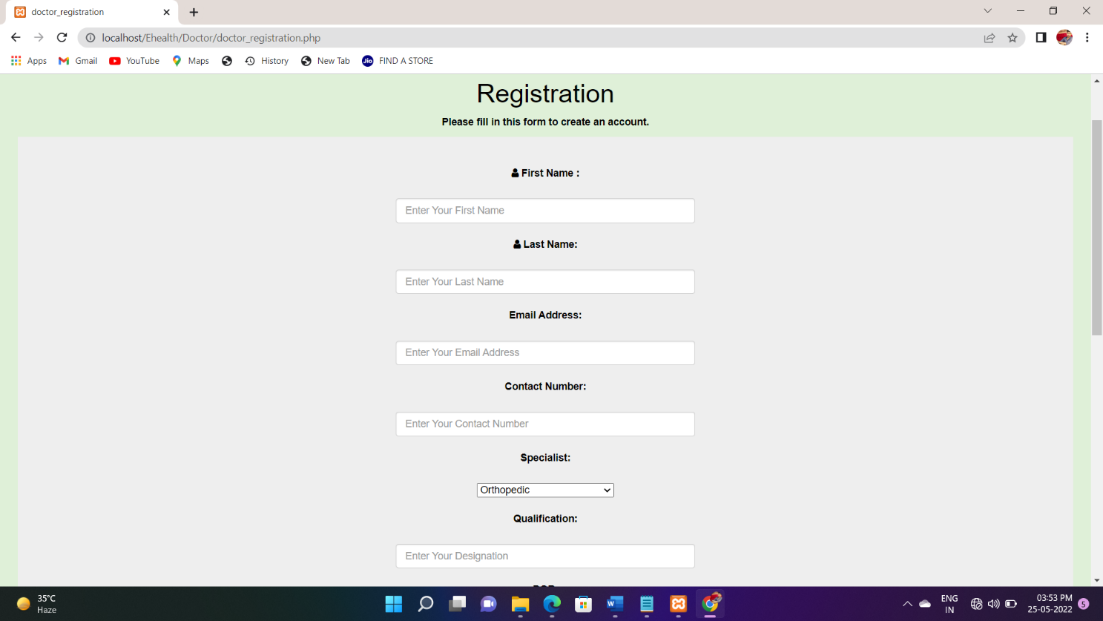
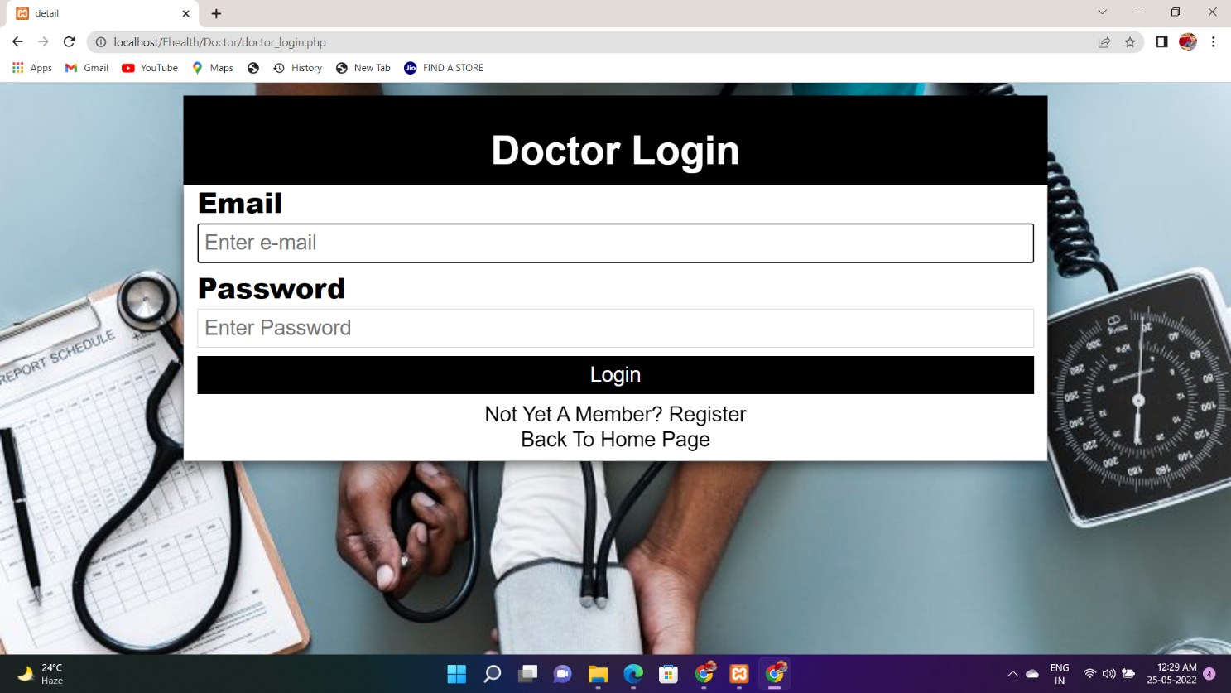
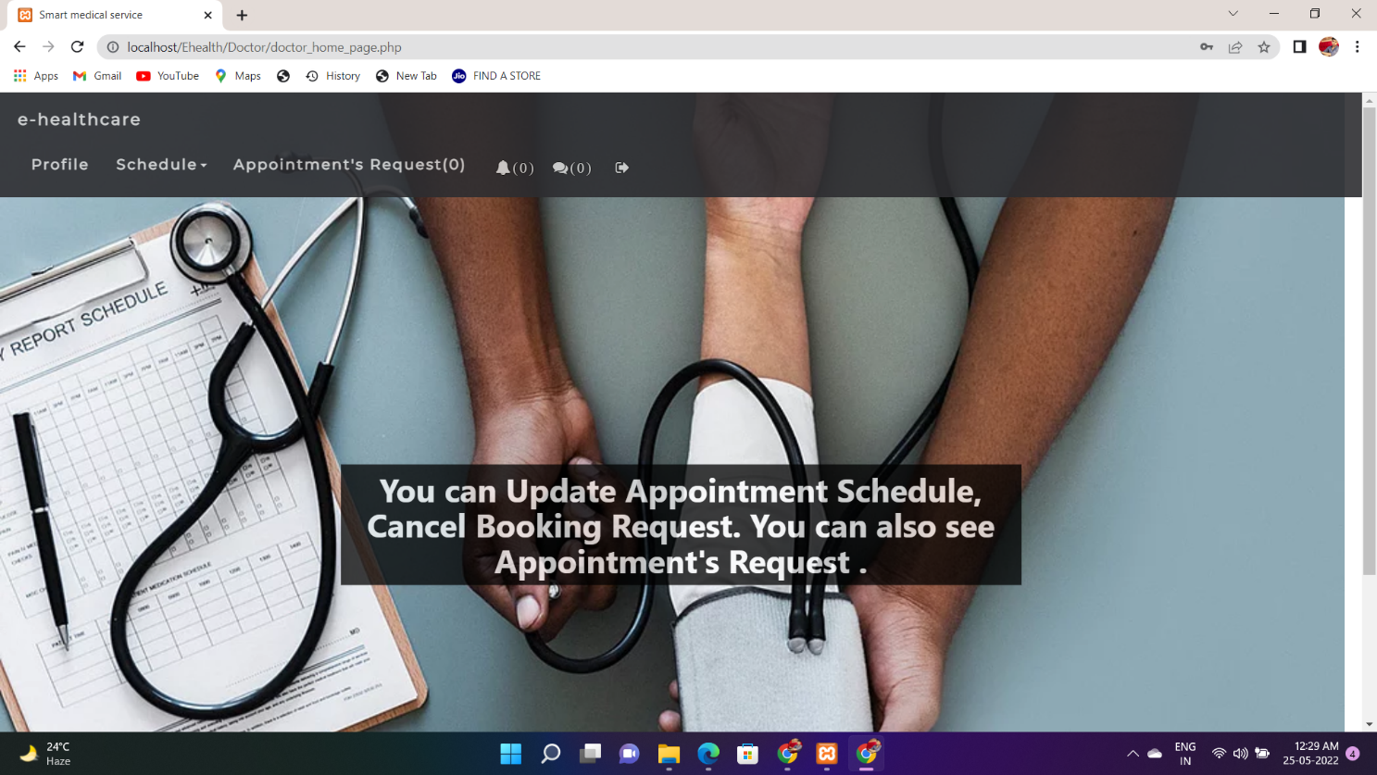
Figure 5 : After Login of User
Figure 6 : Doctor Registration page
Figure 7 : Doctor Login Page
Figure 8 : After Login of Doctor
Figure 6 : Doctor Registration page
Figure 7 : Doctor Login Page

Slide 15
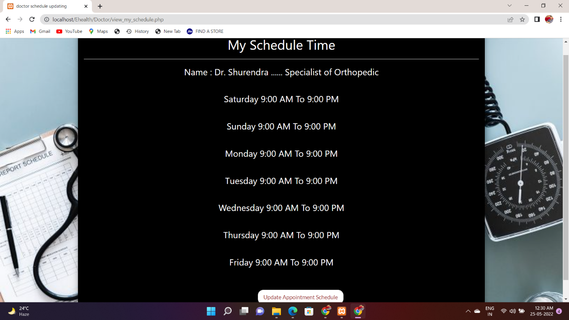
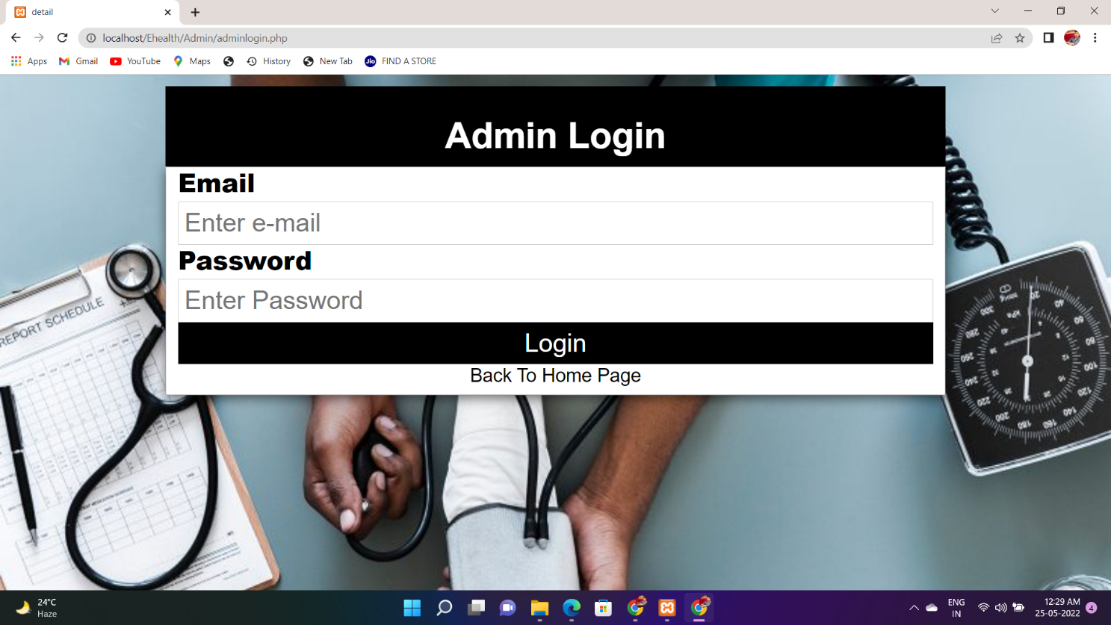
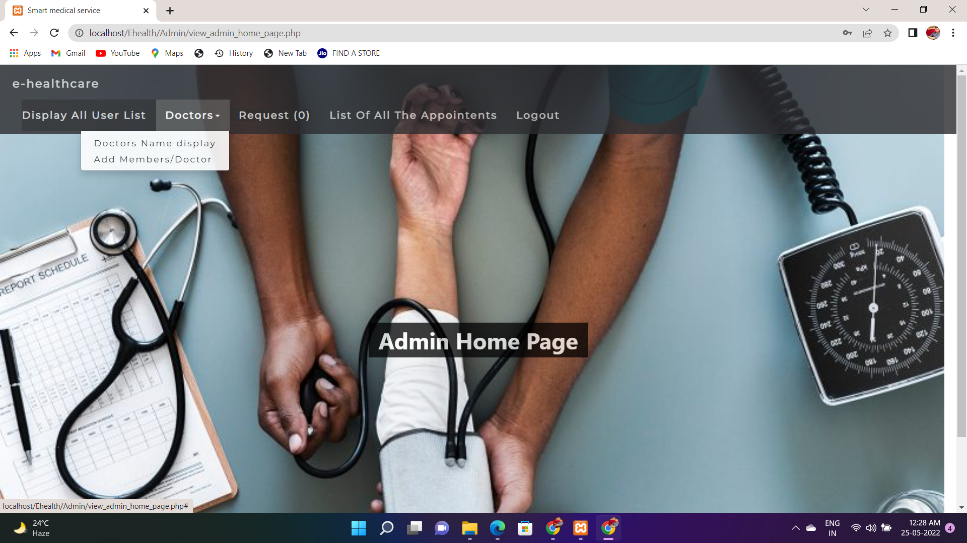
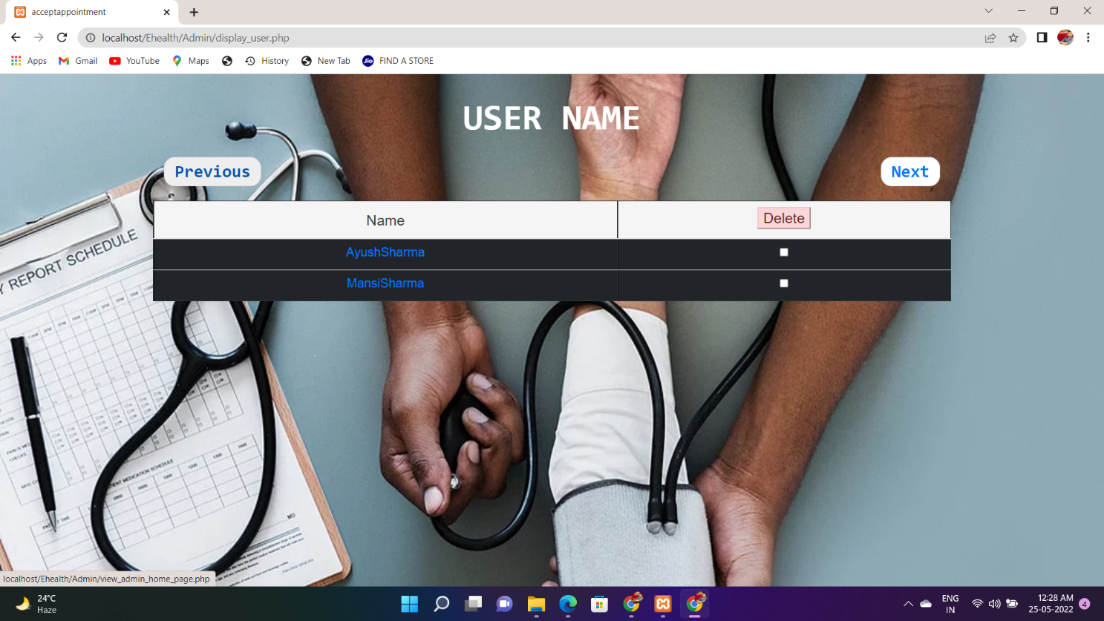
Figure 9 : Update Schedule Page For the Doctor
Figure 10 : Admin Login
Figure 11 : After Admin Login
Figure 12 : Display All User List By Admin

Slide 16
CONCLUSION
Patients are increasingly looking at convenient ways to book appointments. They prefer to use options available on their mobile or laptop to book appointments. An online doctor booking appointment system that integrates seamlessly with an Electronic Health Record (EHR) is ideal for doctors as well. It reduces fatigue and frustration. Adopting digital technologies involving the use of appropriate tools is recommended for doctors. The pandemic has made sure that digital modes are embraced even by sections of society that was either hesitant earlier or had limited access to the to the internet or such tools. Patients are also likely to be more welcoming of these tools. Having a presence on the internet is a starting point. Having a convenient appointment system using which patients can reach you is the next step. Every doctor should adopt digital tools lest they be left behind. In addition to building a digital presence for doctors, we also integrate the appointment booking system which in turn integrates with the E.H.R.

Slide 17
References & Bibliography
Help From Internet
HTML , CSS & Php :
https://www.w3schools.com/
Software Engineering :
https://www.tutorialspoint.com/software_engineering/
https://www.javatpoint.com/software-engineering-data-flow-diagrams
https://www.geeksforgeeks.org/module-specifications-in-software-engineering/
Database :
https://www.tutorialspoint.com/sql/index.htm
https://docs.phpmyadmin.net/en/latest/user.html

Slide 18
About Website testing :
https://www.tutorialspoint.com/software_testing_dictionary/web_application_testing.htm
https://www.guru99.com/web-application-testing.html
Help in Documentation & Other :
https://www.numa.com/blog/how-appointment-scheduling-software-works
https://www.scribd.com/document/342098953/Doctor-Appointment-System#fullscreen&from_embed
https://www.genamet.com/resources/blog/the-advantages-of-using-a-doctor-appointment-booking-system

Slide 19
Thank you

